Slide 1
Data Mining for Intrusion Detection

Slide 2
Why do we need protection?
Cyberattacks still on rise
Threat of cyber-terrorism, more coordinated
Even sensitive installations not well-secured, regular breakins
Change in demographic: attacks require less sophisticated attackers.

Slide 3
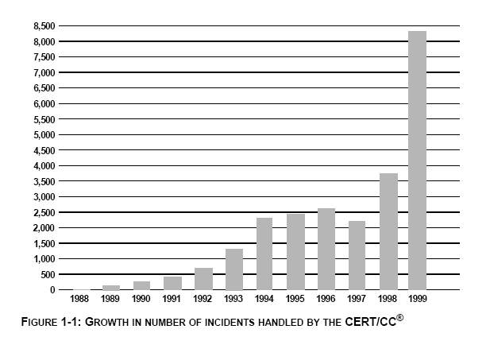
Incidents Increasing

Slide 4
What is an attack?
Perspective matters
Victim: intrusion of loss or consequence
Attacker: achieved specific goals
Generally, if the victim has been affected, we say he has been attacked
Intrusion: successful attack
Even attacker-unsuccessful attempts may be intrusion. (ie Machine crashed)

Slide 5
Breakdown of an Intrusion
Intrusion begins when intruder takes steps to fulfill objectives
A flaw or weakness must be exploited, either by hand or with a precrafted tool
Flaws include social engineering: human processes can weaken security/integrity
Intrusion ends when attacker succeeds or gives up.
Attacks can have multiple victims or attackers

Slide 6
Goals of IDS
Answer the questions:
  What happened?
  Who was affected? Who was the attacker?
  How are they affected? How did the intrusion occur?
  Where and when did the intrusion originate?
  Why were we attacked?
ID aims to positively identify all attacks and negatively identify all non-attacks

Slide 7
Intrusion Detection Approaches
Define and extract the features of behavior in system
Define and extract the Rules of Intrusion
Apply the rules to detect the intrusion
Audit Data
3
Training
Audit Data
Features
Rules
Pattern matching
or Classification
1
2
3

Slide 8
Thinking about The Intrusion Detection System
Intrusion Detection system is a pattern discover and pattern recognition system.
The Pattern (Rule) is the most important part in the Intrusion Detection System
  Pattern(Rule) Expression
  Pattern(Rule) Discover
  Pattern Matching & Pattern Recognition.

Slide 9
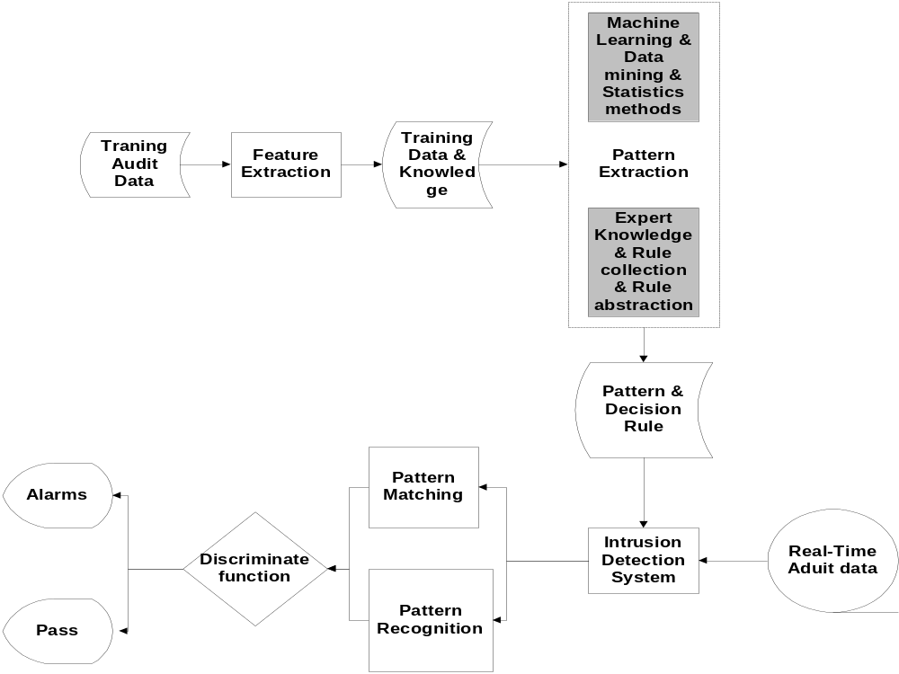

Slide 10
Rule Discover Method
Expert System
Measure Based method
  Statistical method
  Information-Theoretic Measures
  Outlier analysis
Discovery Association Rules
Classification
Cluster

Slide 11
Pattern Matching & Pattern Recognition Methods
Pattern Matching
State Transition & Automata Analysis
Case Based reasoning
Expert System
Measure Based method
  Statistical method
  Information-Theoretic Measures
  Outlier analysis
Association Pattern
Machine Learning method

Slide 12

Association Rules
Motivated by market-basket analysis
Generate Rules that capture implications between attribute values
Rule Example
  Lettuce & Tomato -> Salad Dressing [0.4, 0.9]
Parameters [s, c]
  Support (s) % records satisfy LHS and RHS
  Confidence (c) = P(satisfies RHS | satisfies LHS)
Mining Problem
  “Find all association rules that have support and confidence > user-defined minimum value”
Data Mining in Intrusion Detection

Slide 13

Association Pattern Discover
Goal is to derive multi-feature (attribute) correlations from a set of records.
An expression of an association pattern:
The Pattern Discover Algorithm:
  Apriori Algorithm
  FP(frequent pattern)-Tree

Slide 14
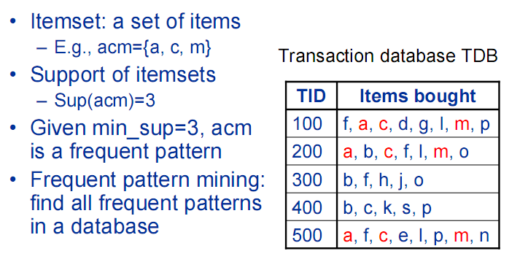
Association Pattern Example

Slide 15
Association Pattern Detecting
Statistics Approaches
  Constructing temporal statistical features from discovered pattern.
  Using measure-based method to detect intrusion
Pattern Matching
  Nobody discuss this idea.

Slide 16
Classification: A Two-Step Process
Model construction: describe a set of predetermined classes
  Training dataset: tuples for model construction
    Each tuple/sample belongs to a predefined class
  Classification rules, decision trees, or math formulae
Model application: classify unseen objects
  Estimate accuracy of the model using an independent test set
  Acceptable accuracy → apply the model to classify data tuples with unknown class labels

Slide 17
Classification Methods
Basic Algorithm ID3
Neural networks
Bayesian classification
  Naïve Bayesian classification
  Bayesian belief network
Support vector machines

Slide 18
Classification for Intrusion Detection
Misuse detection
  Classification based on known intrusions
Example: Sinclair et al. “An application of machine learning to network intrusion detection”
  Use decision trees and ID3 on host session data
  Use genetic algorithms to generate rules
    If <pattern> then <alert>

Slide 19
HIDE
“A hierarchical network intrusion detection system using statistical processing and neural network classification” by Zheng et al.
Five major components
  Probes collect traffic data
  Event preprocessor preprocesses traffic data and feeds the statistical model
  Statistical processor maintains a model for normal activities and generates vectors for new events
  Neural network classifies the vectors of new events
  Post processor generates reports

Slide 20
Intrusion Detection by NN and SVM
S. Mukkamala et al., IEEE IJCNN May 2002
Discover useful patterns or features that describe user behavior on a system
Use the set of relevant features to build classifiers
SVMs have great potential to be used in place of NNs due to its scalability and faster training and running time
NNs are especially suited for multi-category classification

Slide 21
A Systematic Framework—J.Stolfo et al.
Build good models:
  select appropriate features of audit data to build intrusion detection models
Build better models:
  architect a hierarchical detector system that combines multiple detection models
Build updated models:
  dynamically update and deploy new detection system as needed

Slide 22
A Systematic Framework
Support for the feature selection and model construction:
  Apply data mining algorithms to find consistent inter- and intra- audit record (event) patterns
  Use the features and time windows in the discovered patterns to build detection models
  A support environment to semi-automate this process

Slide 23
A Systematic Framework
Combining multiple detection models:
  Each (base) detector model monitors one aspect of the system
  They can employ different techniques and be independent of each other
  The learned (meta) detector combines evidence from a number of base detectors
An intelligent agent-based architecture:
  learning agents: continuously compute (learn) the detection models
  detection agents: use the (updated) models to detect intrusions

Slide 24
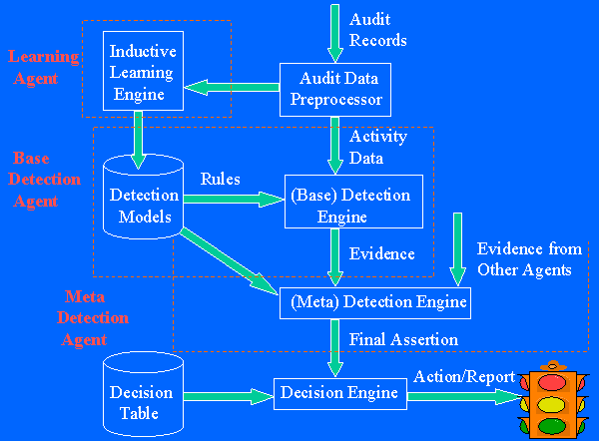
A Systematic Framework

Slide 25
Building Classifiers for Intrusion Detection—J.Stolfo et al.
Experiments in constructing classification models for anomaly detection
Two experiments:
  sendmail system call data
  network tcpdump data
Use meta classifier to combine multiple classification models

Slide 26
Classification Models on sendmail
The data: sequence of system calls made by sendmail.
Classification models (rules): describe the “normal” patterns of the system call sequences.
The rule set is the normal profile of sendmail
Detection: calculate the deviation from the profile
  large number/high scores of “violations” to the rules in a new trace suggests an exploit

Slide 27
Classification Models on sendmail
The sendmail data:
  Each trace has two columns: the process ids and the system call numbers
  Normal traces: sendmail and sendmail daemon
  Abnormal traces: sunsendmailcap, syslog-remote, syslog-remote, decode, sm5x and sm56a attacks

Slide 28
Classification Models on sendmail
Lessons learned:
  Normal behavior can be established and used to detect anomalous usage
  Need to collect near “complete” normal data in order to build the “normal” model
  But how do we know when to stop collecting?
  Need tools to guide the audit data gathering process

Slide 29
Classification Models on tcpdump
The tcpdump data (part of a public data visualization contest):
  Packets of incoming, out-going, and internal broadcast traffic
  One trace of normal network traffic
  Three traces of network intrusions

Slide 30
Data Preprocessing
Extract the “connection” level features:
  Record connection attempts
  Watch how connection is terminated
Each record has:
  start time and duration
  participating hosts and ports (applications)
  statistics (e.g., # of bytes)
  flag: normal or a connection/termination error
  protocol: TCP or UDP
Divide connections into 3 types: incoming, out-going, and inter-lan

Slide 31
Building Classifier for Each Type of Connections
Use the destination service (port) as the class label
Training data: 80% of the normal connections
Testing data: 20% of the normal connections and connections in the 3 intrusion traces
Apply RIPPER to learn rules

Slide 32
Lessons Learned
Data preprocessing requires extensive domain knowledge
Adding temporal features improves classification accuracy
Need tools to guide (temporal) feature selection

Slide 33
Meta Classifier that Combines Evidence from Multiple Detection Models
Build base classifiers that each model one aspect of the system
The meta learning task:
  each record has a collection of evidence from base classifiers, and a class label “normal”or “abnormal” on the state of the system
Apply a learning algorithm to produce the meta classifier

Slide 34
Reference
http://www.cs.kent.edu/~jin/dataminingcourse/intrusiondection.ppt

